Slide 1
Application of Artificial Neural Networks in COVID-19 and pneumonia cases diagnosis via CXR images: A comprehensive analysis of Conv. Net. and Vision Transformers
Lecturer: Dr. Tien-Dung Mai
Executor: Viet-Hoang Tran (18520785)

Slide 2
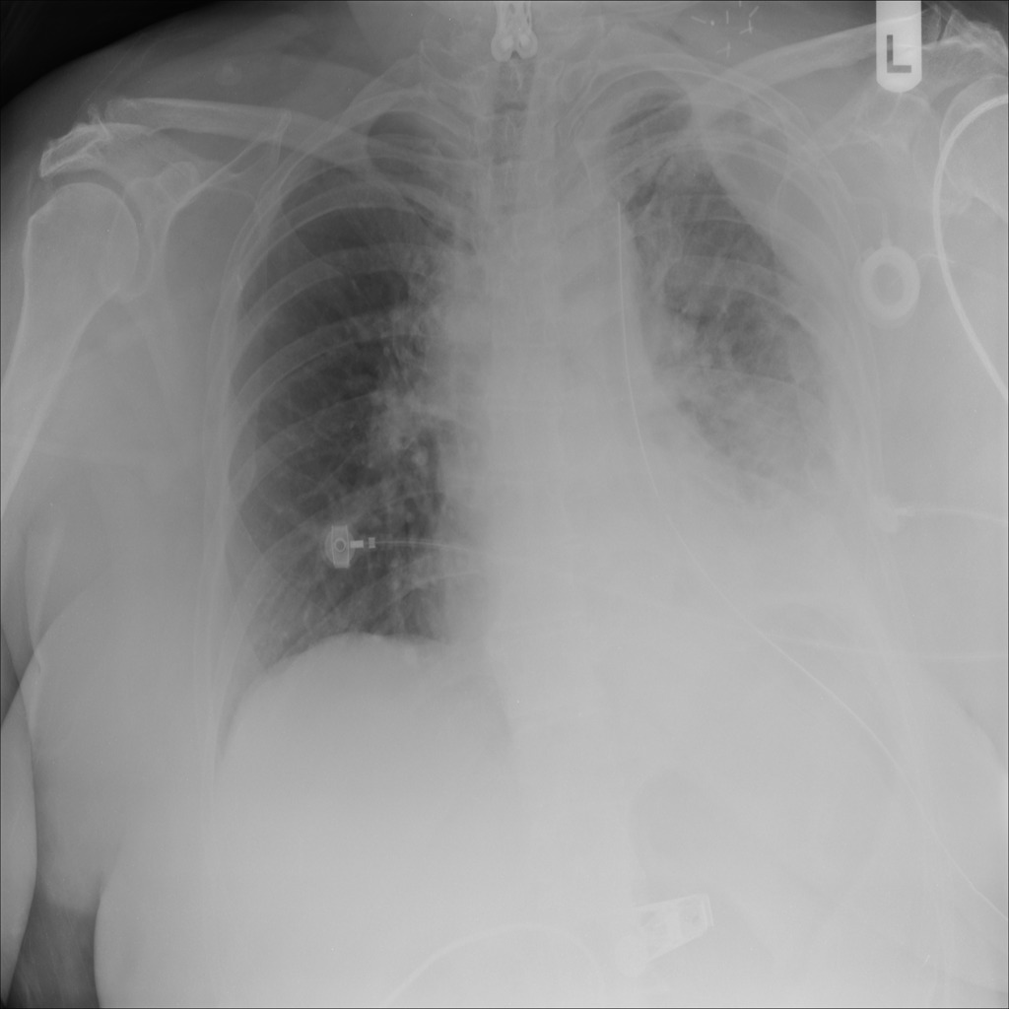
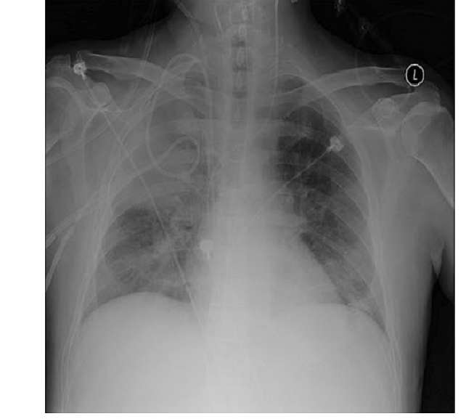
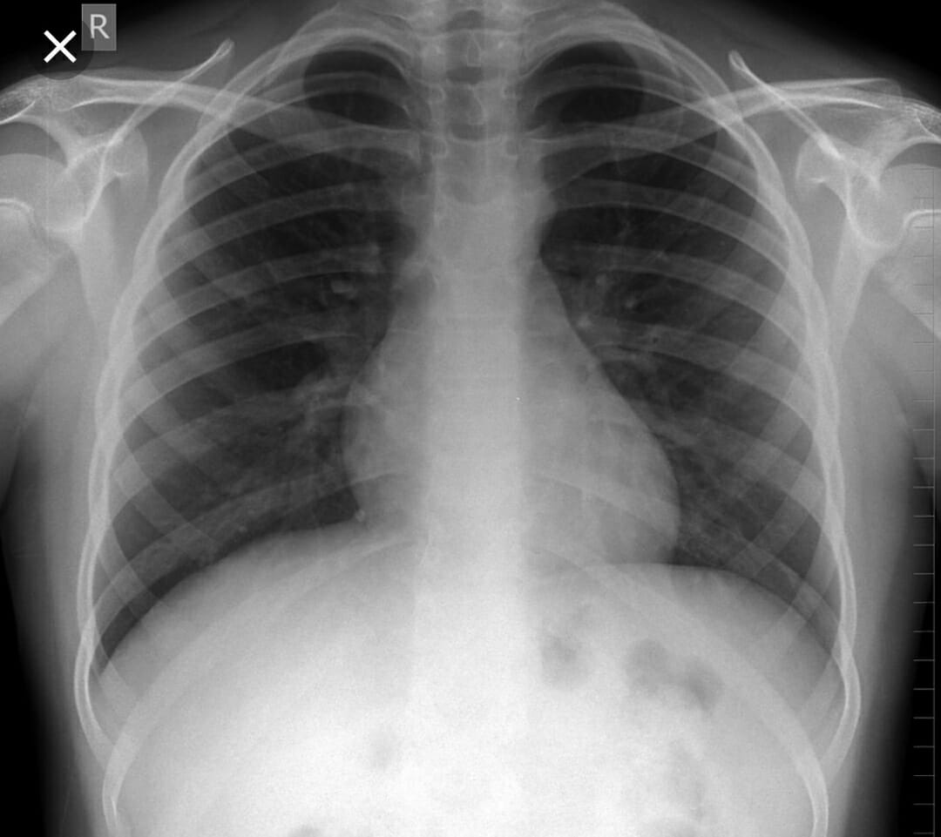
Diagnositic imaging via Chest X-ray
(*)
COVID-19 pneumonia
Viral pneumonia
Normal (no respiratory disease)
+ Generally, similar to Viral pneumonia, the density of white spots (medically known as the ground glass pattern) is increased in the case of COVID-19, which causes whiteness in the lungs on radiology.
+ The specialist can confirm the disease by the appearance of a ground-glass pattern due to the increased whiteness.
+ These two diseases are difficult for radiologists to distinguish since their visual manifestations and medical symptoms are similar. It is a challenge for radiologists who are inexperienced with respiratory diseases.
Lack of human resources for the anti-epidemic work.
Solution: using the power of Artificial Neural Network for the clinical diagnosis. Economize finance and human resources!
(*) COVIDx dataset.

Slide 3
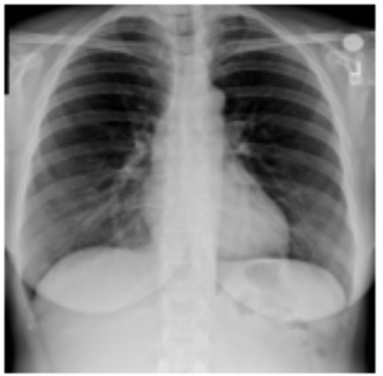
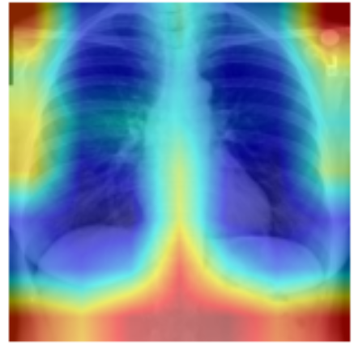
Diagnositic imaging via Chest X-ray
Prediction
Normal: 94.55%
Pneumonia: 5.16%
COVID-19: 0.29%
Input image
Other works (*): Convolutional neural networks
Our work: the SOTA Vision Transformer-based neural network
Artificial Neural Network
Heatmap generation
(*) Bhattacharya et al. (2021)

Slide 4
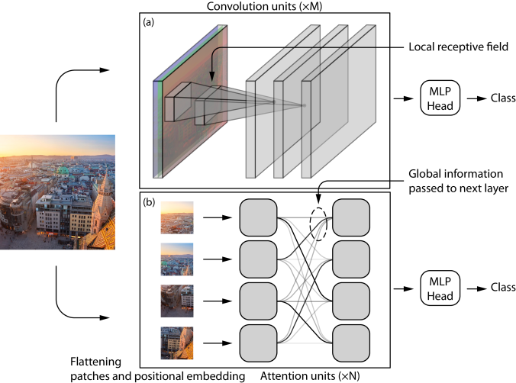
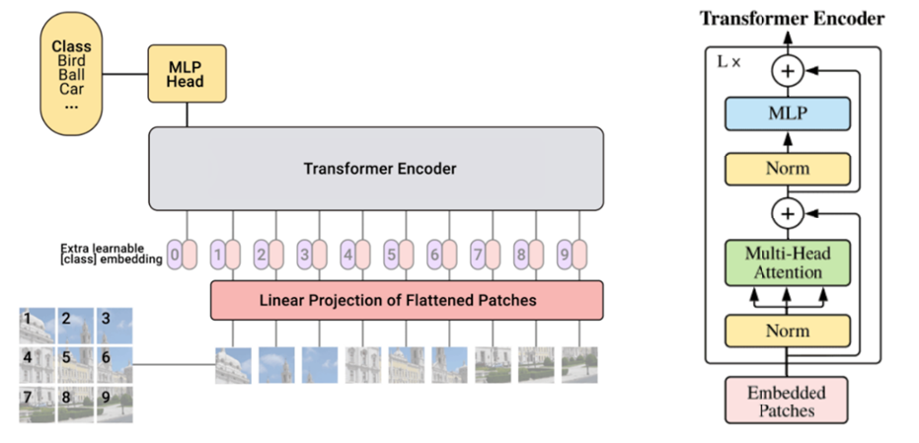
Relative of MHSA and Conv. layer
Vision Transformers
L = 24
(**)
(*)
(***)
Bird-eye views of the convolutional (a) and the Transformer-based (b) network
Architecture of ViT, the first Transformer-based neural network with convolution-free (left) for image classification and the Encoder architecture (right).
(**)
(*) Dosovitskiy et al. (2020) (**) Cordonnier et al. (2020) (***) Tuli et al. (2021)

Slide 5
Comparison of ViT and CNN (ResNet)
1. Consistency with human vision
2. Local/global information preservation
3. Computational complexity
4. Data demanding
5. Data augmentation, Optimization
6. Layer extending (extra)
7. Adapt to pixel-level prediction tasks (extra)

Slide 6
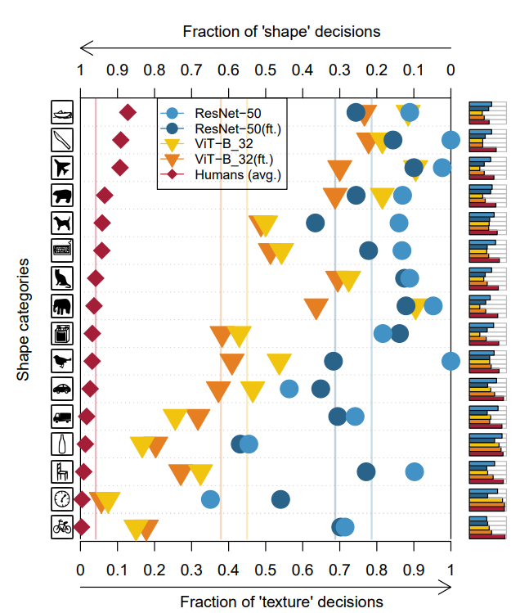
Consistency with human vision
(*)
Comparison of ‘texture’ and ‘shape’ bias of the standard ResNet-50 and ViT-B/32 before / after fine-tuning (denote as ft.) and human vision.
(Fine-tuning with simple image augmentation in the ImageNet dataset can encourage the shape bias.)
=> Vision Transformers get more consistent with human vision.
(*) Tuli et al. (2021)

Slide 7
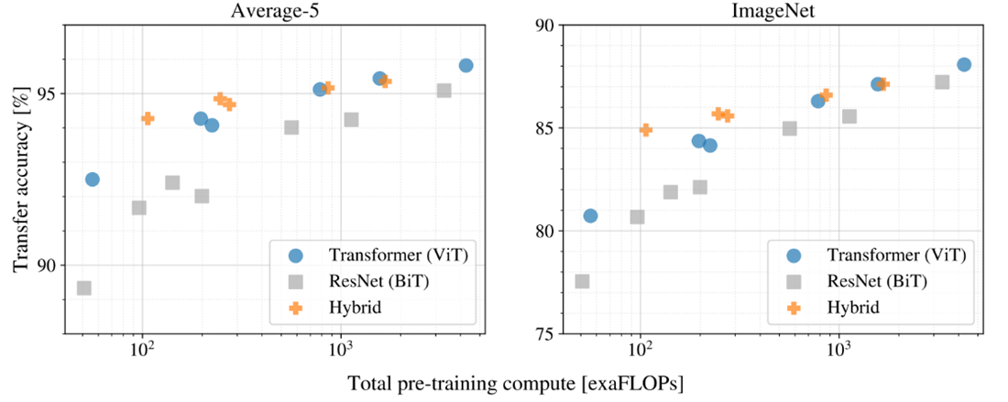
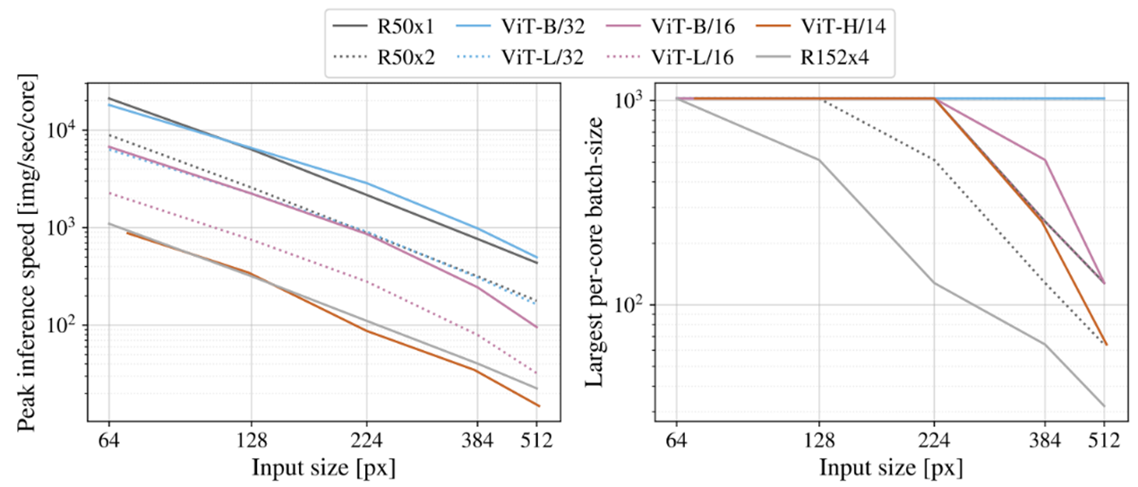
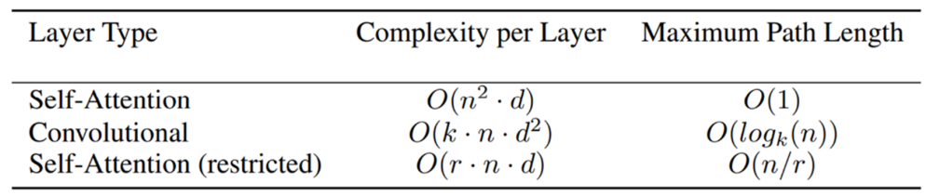
Computational complexity
(**)
(*)
Where:
n is the input dimension
d is the representation dimension (of the linear projection matrices in Self-attention layer or convolution kernels in convolutional layer.)
k is the convolution kernel size
r is the size of neighborhood in restricted Self-attention
O(n/k) in regular convolution
O(log_{k}n) in dilated convolution
Left figure shows how many images one core can handle per second, across input image sizes of various architecturee, ResNet: R50x1, R50x2, R152x4 and ViT: B/32, L/32, B/16, L/16, H/14. Where B, L, H represent Base, Large and Huge number of parameters respectively and /32, /16 represent to 32×32, 16×16 input patch size.
Right figure shows the largest batch-size of each model can fit into the same core across input sizes with the same computation core, the larger is better for scaling to the large dataset.
Transfer performance (vertical axis) versus pre-training computation extraFLOPs (horizontal axis) of different architectures: ViT, ResNet (BiT) and Hybrid on average over 5 different datasets (left figure), and ImageNet dataset (right figure).
=> Vision Transformers has less computational complexity than ResNet. But the complexity goes dramatically when the image size increases.
=> Self-attention layer is quadratic complexity with respect to image size. And conv. layer is quadratic complexity with respect to the hidden dimension.
(*) Vaswani et al. (2017) (**) Dosovitskiy et al. (2020)

Slide 8
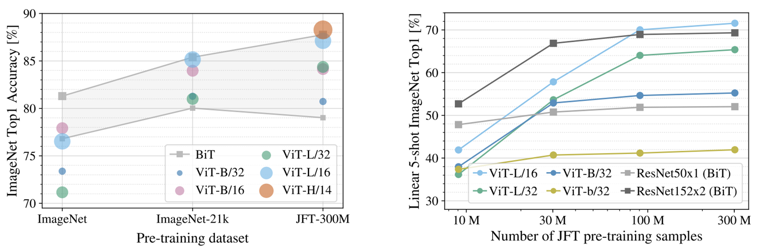
Data demanding
(*)
Left figure is the transfer results of pre-training different ViT and BiT models on (ImageNet, ImageNet-21K and JFT-300M) dataset.
Right figure is the few-shot evaluation results of these models versus different training sizes in the JFT dataset. ResNets perform better with smaller pre-training datasets but plateau sooner than ViTs, which perform better with larger pre-training. ViT-b is ViT-B with all hidden dimensions halved.
=> Vision Transformers requires more data to achieve higher performance than ResNet.
(*) Dosovitskiy et al. (2020)

Slide 9
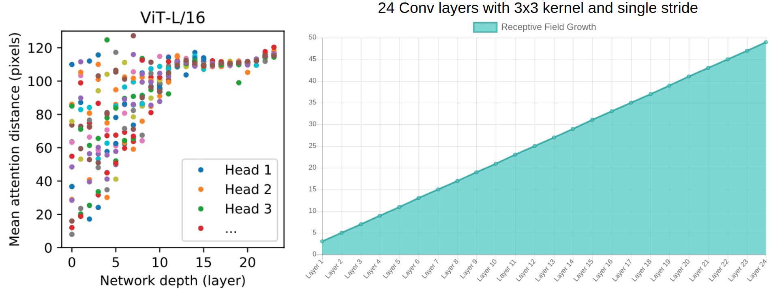
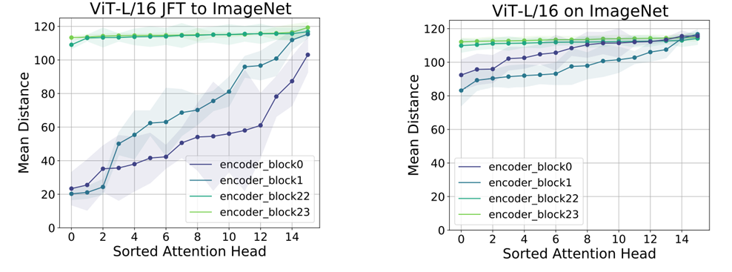
Effect of data amount to ViT’s learning behavior
(**)
(*)
=> If trained with insufficient data, ViT does not achieve the local learning behavior like CNN. Therefore getting a worse performance.
Mean of the Self-Attention distances of pixels by head through layers of ViT which are fine-tuned with ImageNet from large-scale pre-trained JFT-300M (left) and training-only on ImageNet (right).
(left) Mean of the Self-Attention distances of the ViT trained with sufficient data through Transformer blocks.
(right) The increase of receptive field through convolutional layers.
(*) aisummer.com (**) Raghu et al. (2021)

Slide 10
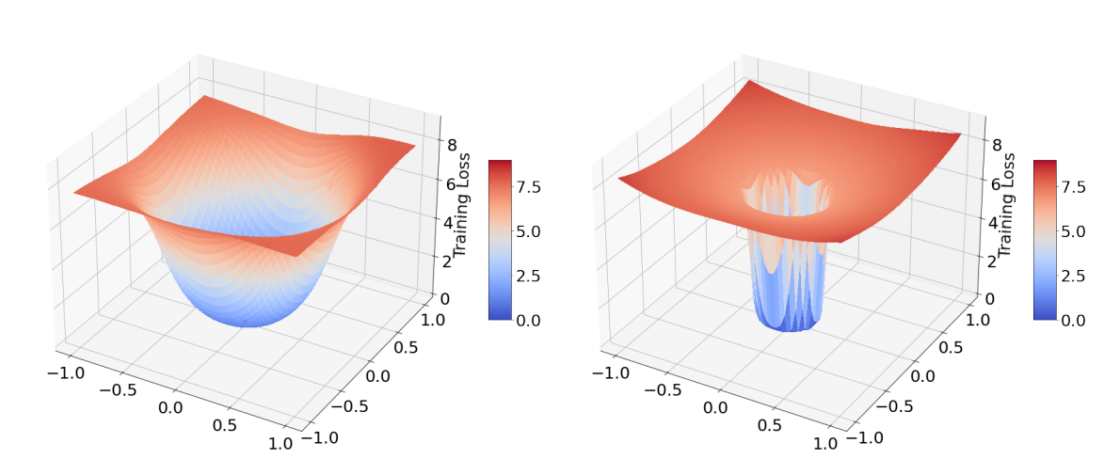
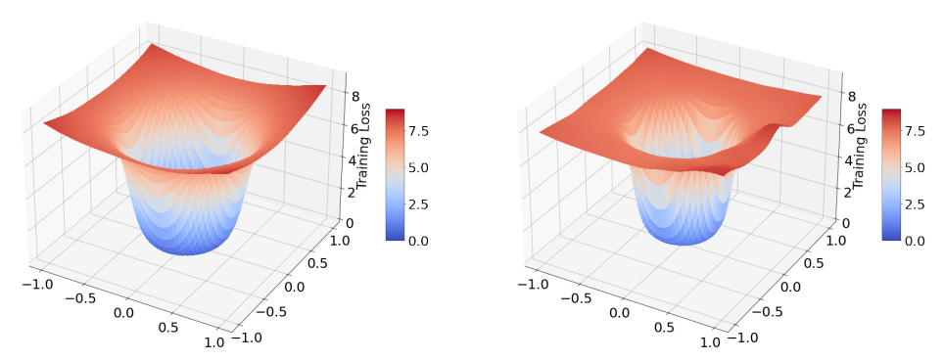
Data augmentation and Optimization
The ViT’s authors^{(*)} confirm that the lack of convolution-like inductive biases is a challenge for training ViT model.
No translational equivariant
Have no locality behavior if trained with insufficient data.
Recent work ^{(**)} shows that ViT models are sensitive to the choice of optimizer.
Specifically, it requires the sophisticated tuning of hyperparameters; strong data augmentations and large-scale pre-trained dataset to avoid over-fitting.
(***)
Cross-entropy loss landscape of super deep ResNet-152 (left) and ViT-B/16 (right)
training on 10% ImageNet dataset
Smother cross-entropy loss landscape of ViT-B/16 (left) when trained with strong augmentation (middle) or trained with more sufficient data (right).
(*) Dosovitskiy et al. (2020) (**) Touvon et al. (2021) (***) Chen et al. (2021)

Slide 11
Summary: Comparison of ViT and CNN (ResNet)
1. Consistency with human vision:
=> ViT gets more consistency with human vision than CNN.
2. Local/global information preservation:
=> ViT can preserve the global information in the early layers but need sufficient training data to focus on the local feature.
3. Computational complexity
=> ViT has less computational complexity than ResNet. But the complexity goes dramatically when the image size increases.
4. Data demanding
=> If trained with insufficient data, ViT does not achieve the local learning behavior like CNN. Therefore getting a worse performance.
Data augmentation, Optimization
=> ViT is sensitive to the choice of optimizer.
Requires the sophisticated tuning of hyperparameters; strong data augmenttations and large-scale pre-trained dataset to avoid over-fitting.

Slide 12
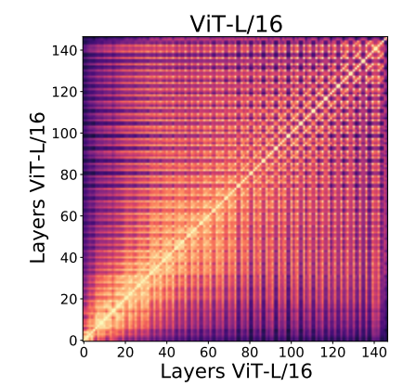
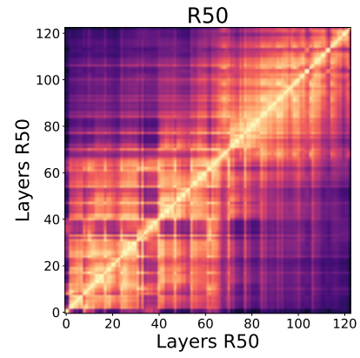
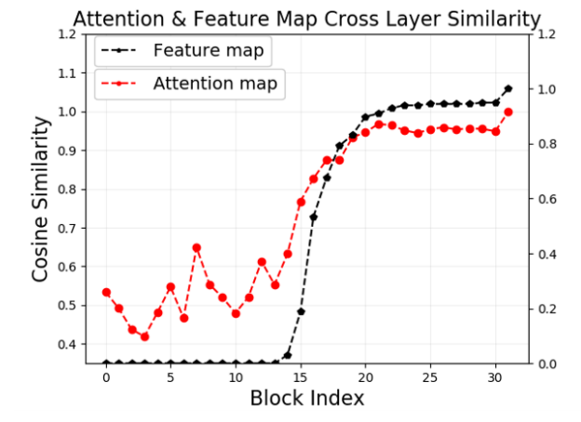
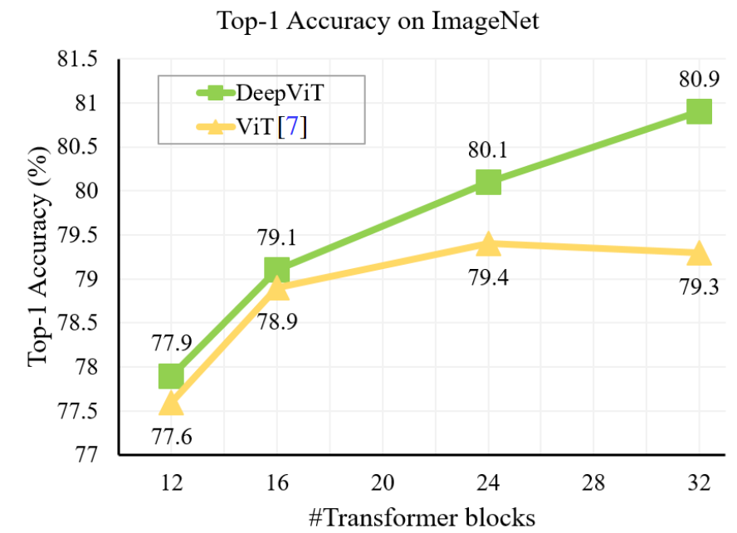
About Layer extending
(**)
(*)
(left) Cross layer similarity of attention map and features for ImageNet-1k pre-trained ViT.
(right) Higher similarity of layer and feature map structure leads to poor performance on ImageNet benchmark.
Heat map of the layers similarity structure ViT (left) and ResNet-50 (right)
(*) Raghu et al. (2021) (**) Zhou et al. (2021)

Slide 13
How about ViT for the pixel-dense prediction tasks...
Kernel size:
3×3 or 5×5
(*)
Patch size:
16×16 or 32×32
(1) The output feature map of ViT is single scale and low resolution.
(2) It takes high computation and memory cost even for large input image sizes. (800×800 in COCO benchmark).
(*) Tuli et al. (2021)

Slide 14
ViT Improvements
There are a lot of improved variants of Transformer networks that start from the success of ViT. Their approaches mainly solve 4 problems:
(1) How to extend or reconstruct ViT to a data-efficient training, better generalizing at inference and saving more computational cost;
(2) How to reinforce the both of local and global representation learning ability in an efficient way;
(3) How to find the compatible optimization, regularization and data augmentation strategy of ViT;
(4) How to make ViT enable to produce multi-scale feature maps with high resolution (like CNN) to address a pixel-dense level prediction tasks
=> Our method: Pyramid Vision Transformer ^{(*)}
(*) Wang et al. (2021)

Slide 15
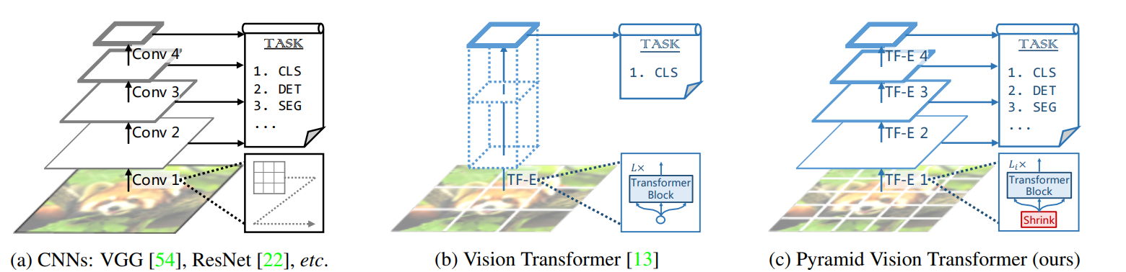
Pyramid Vision Transformer v2^{(*)}
(*) Wang et al. (2/2021), Wang et al. (7/2021)

Slide 16
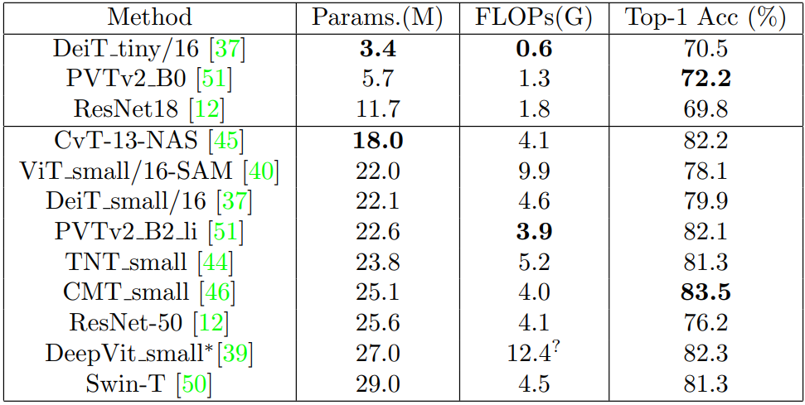
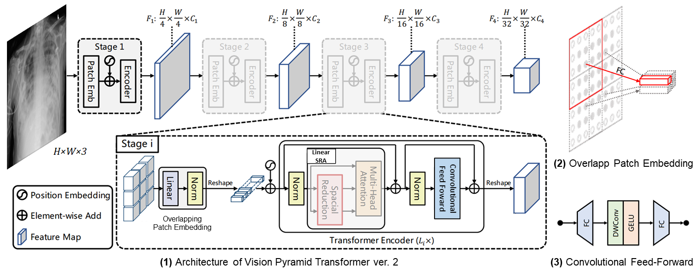
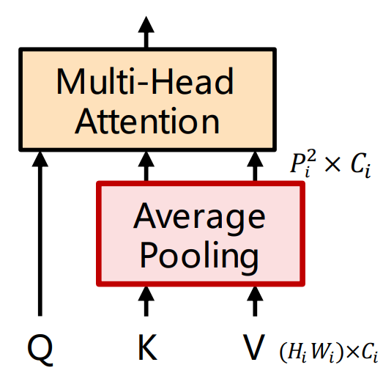
Pyramid Vision Transformer^{(*)}
(4) Linear Spatial-Reduction Attention
Table 1: Performance and robustness of ResNet and Transformers based models on ImageNet benchmark in the segment of tiny and small-scale of parameters. The “FLOPs” computations are under the image size of 224 × 224. * denotes the model trained with knowledge distillation regime. ? for the assumption that 1 FLOP = 2 × MAdd.
Problems (1) (2) (4)
Problem (3)
✓
?
(*) Wang et al. (2/2021), Wang et al. (7/2021)

Slide 17
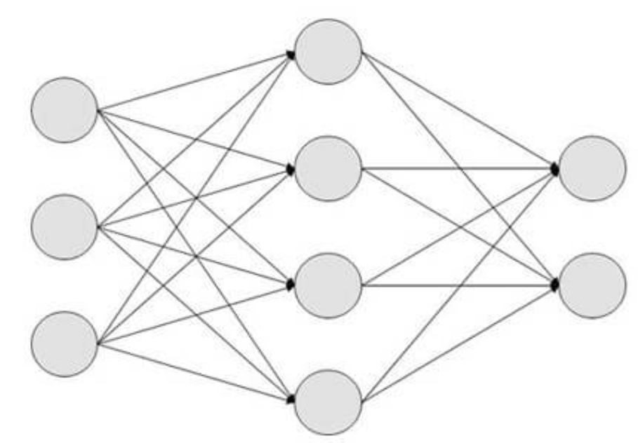
Pyramid Vision Transformer^{(*)}
Normal
Pneumonia
COVID-19
Classification head
Feature extraction head
(*) Wang et al. (2/2021), Wang et al. (7/2021)

Slide 18
Moveback to the task...

Slide 19
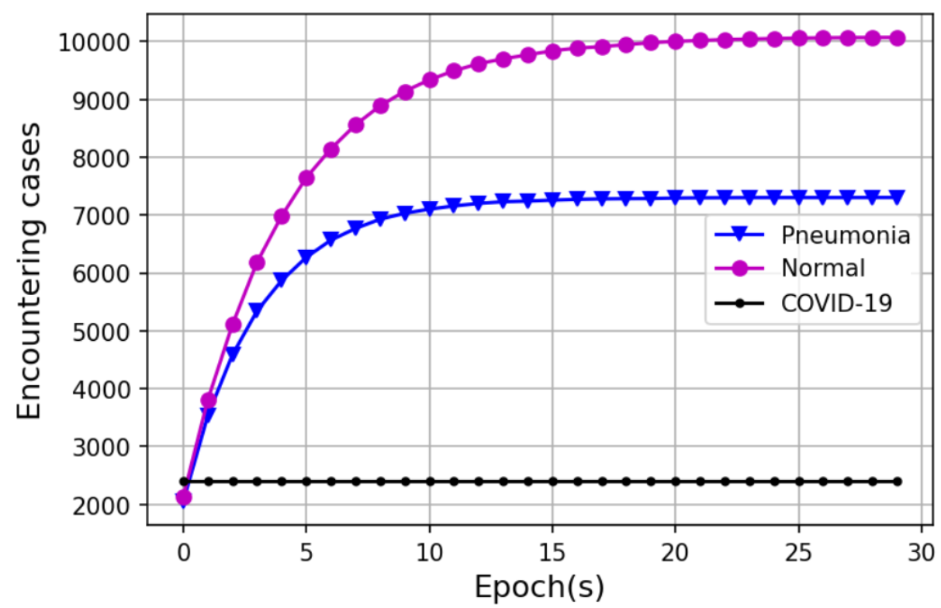
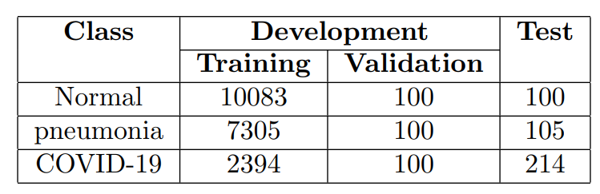
The COVIDx Dataset^{(*)}
We collect a total of 20,401 image of cases in this material dataset, comprising 10,183 normal cases, 7,405 cases confirmed as pneumonia and 2,494 cases confirm as COVID-19 for development set. For test set, we collect 100 normal cases 105 cases confirmed as pneumonia and 214 cases confirm as COVID-19.
Our objective is fast training, so for each training epoch, we stochastically portion 2,394 images of normal and pneumonia classes from the original dataset and load them along with all of COVID-19 cases.
The detail of distribution of image amounts by cases and dataset splitting
(*) The COVIDx dataset

Slide 20
Clinical consideration for data augmentation
Pre-processing and data augmentation
A . Geometric transformations^{(*)} :
Reflection. Both reflections in x-axis and y-axis are not recommended.
Rotation. Applying slight rotations between −5º and 5º are regularly seen in clinical practice, but severe rotations such as ±45º or ±90º are hardly to be encountered and leading noises to the learning model.
Scaling. An equal image scaling in x-axis and y-axis is possible with both large and small scaling. But scaling in only the x-axis or y-axis or severe scaling can be considered not recommended clinically.
Shearing. Sheared images do not exists in medical image, thus this step is not recommended.
Translation. Translation could be a useful augmentation, due to the X-ray images do not always produce lungs in the center of the image. However, there is no clearly recommended range for translation.
All image size => 256×256×3
(*) Elgendi et al. 2021

Slide 21
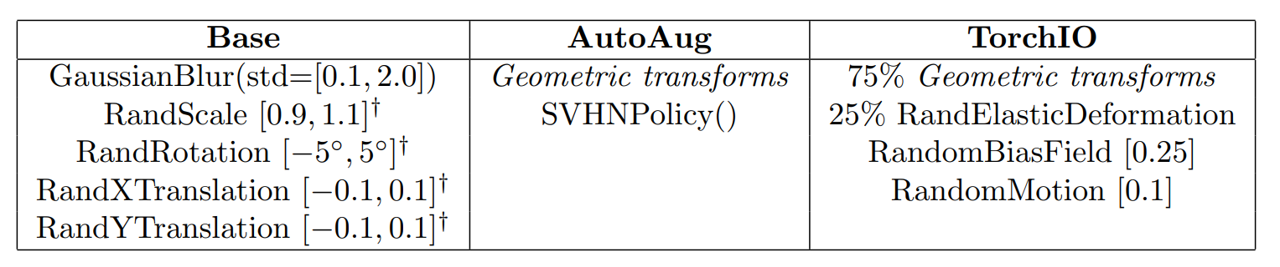
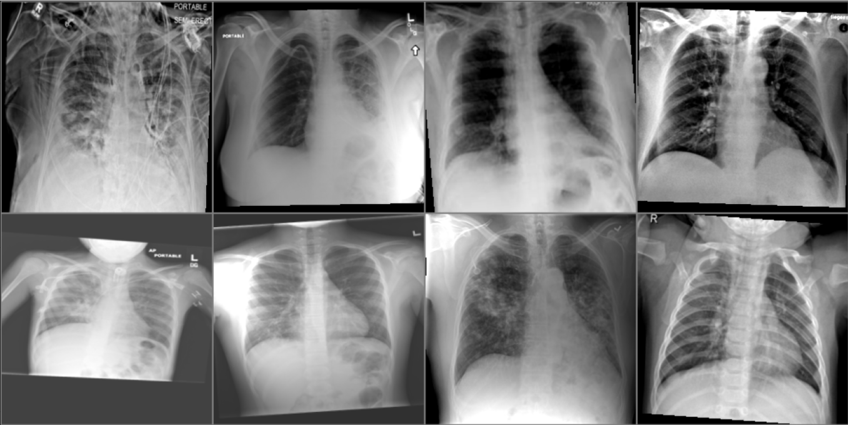
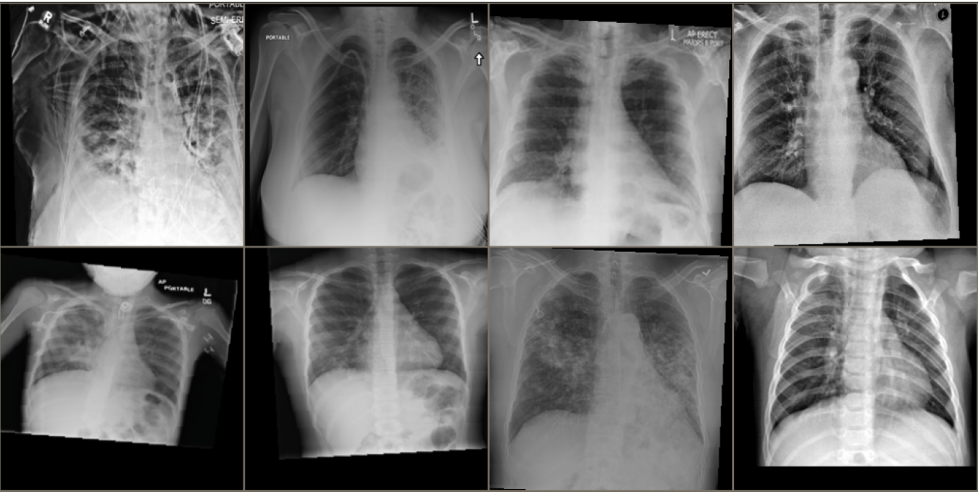
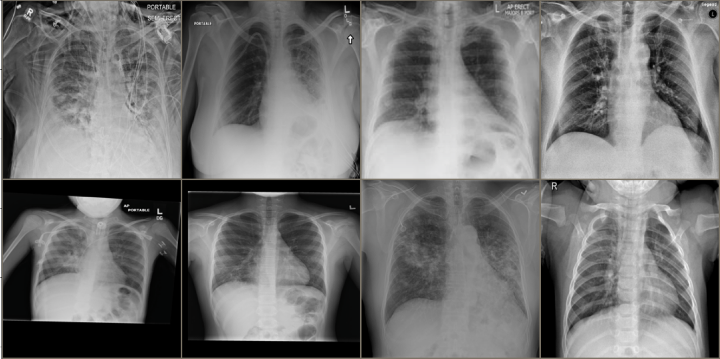
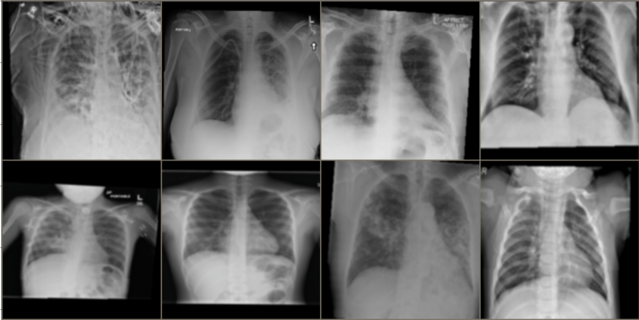
Our augmentation methods
The table describes our 3 augmentation methods
1. Base. We comply and establish data augmentation according to clinical considerations + Blurring.
2. AutoAug.
Geometric transforms is the set of transformations denoted with † and the modified SVHNPolicy() from AutoAug^{(*)}.
Modified SVHNPolicy: removing random coloring, posterizing, pixel inverting amd existing geometric transformations
The remaining operations are the sharpness, brightness, contrast adjusting and the equalize transformation.
3. TorchIO. The TorchIO augmentation has 75% chance of applying this Geometric transforms and remaining 25% chance of applying RandElasticDeformation. Along with it are RandomBiasField and RandomMotion.
Base
AutoAug
No Aug
TorchIO
(*) Cubuk et al. 2018

Slide 22
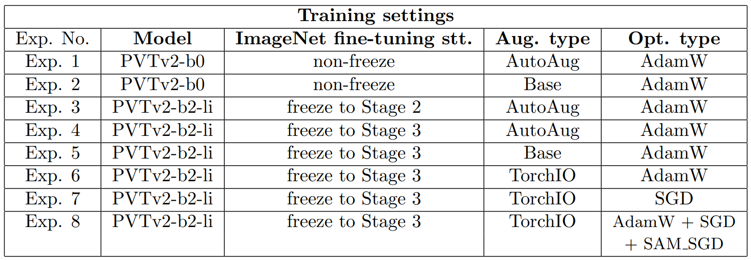
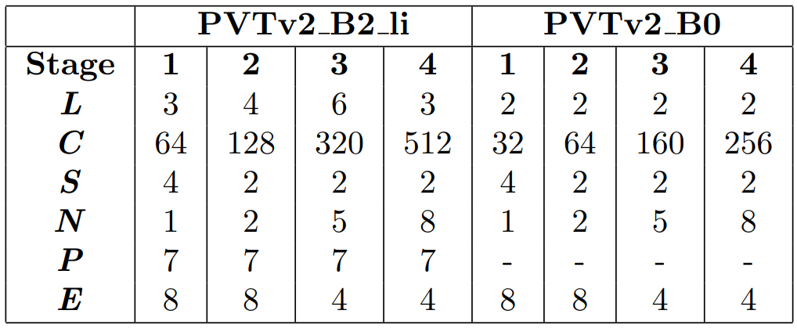
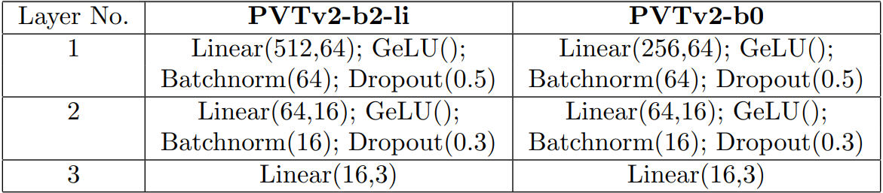
Model configuration
Scnarios implementations
Configuration of feature extraction head
Our scenario of experiments
Model parameters: All_params Trainable Non-trainable
PVTv2-b0 (non-freeze): 3.5M 3.5M 0
PVTv2-b2-li (freeze to Stage 2): 22M 20.4M 1.6M
PVTv2-b2-li (freeze to Stage 3): 22M 12.3M 9.7M
Configuration of classification head

Slide 23
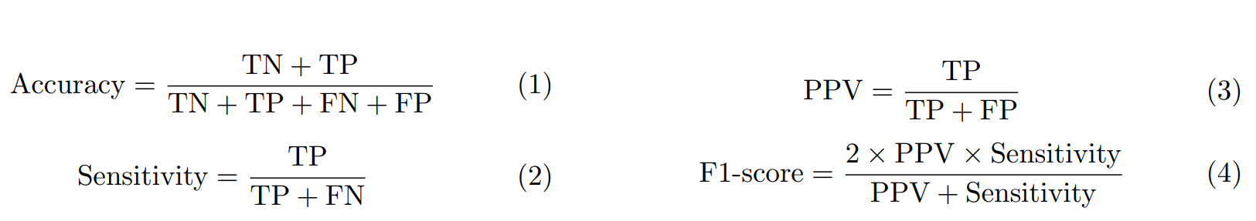
Epidemiological metrics
The model performance is evaluated by using the common statistical measure confusion matrix. From that we obtained various metrics like accuracy and other epidemiological metrics
Accuracy: the metric evaluates the correctness of the model by measuring a ratio of accurately predicted cases out of total number of cases.
(2) Positive predictive value: the ratio of correctly predicted ‘disease’ to the total predicted ‘disease’.
(3) Sensitivity: is the probability that a test will correctly indicate ‘disease’ among those with the truly disease.
(4) F1-score: is the specific measurement in case of uneven class distribution especially with a large number of true negative observations. It provides a balance between metric (2) and (3).
(With: TP: true positive FN: false negative FP: false positive TN: true negative)

Slide 24
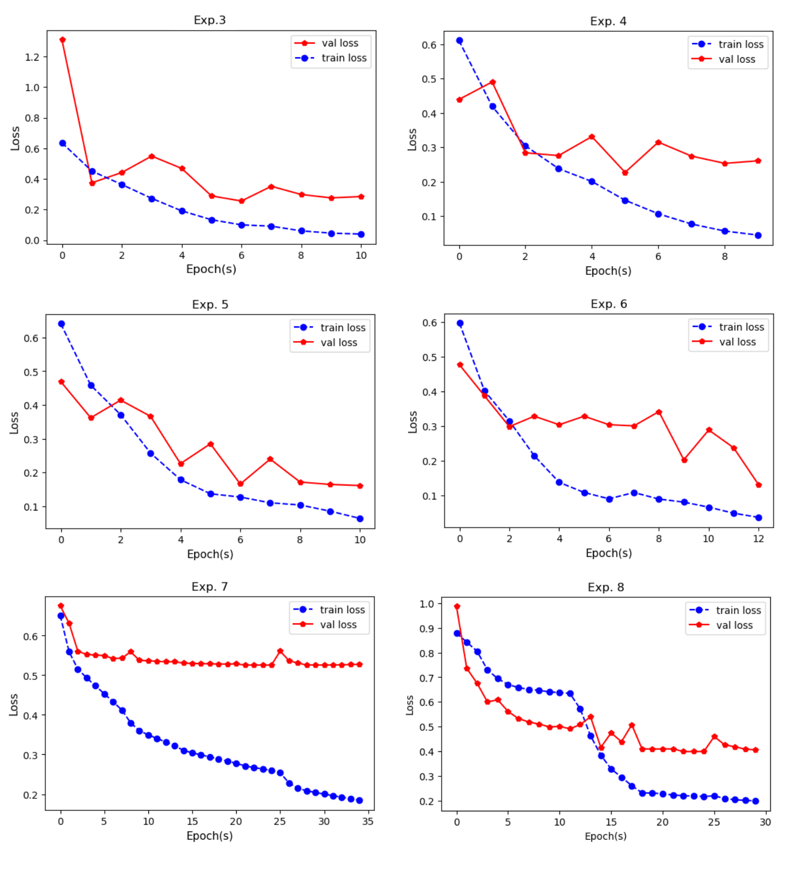
Training progress

Slide 25
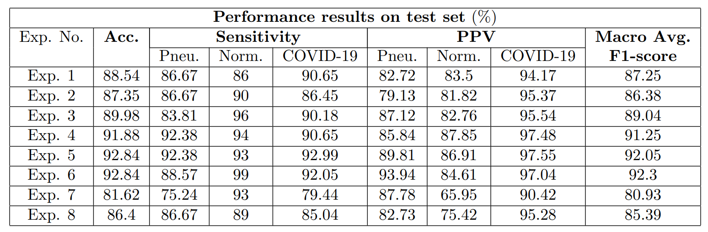
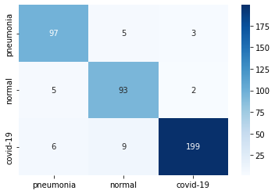
Experiment results
GROUND TRUTH
PREDICTION
Problem (3)
✓

Slide 26
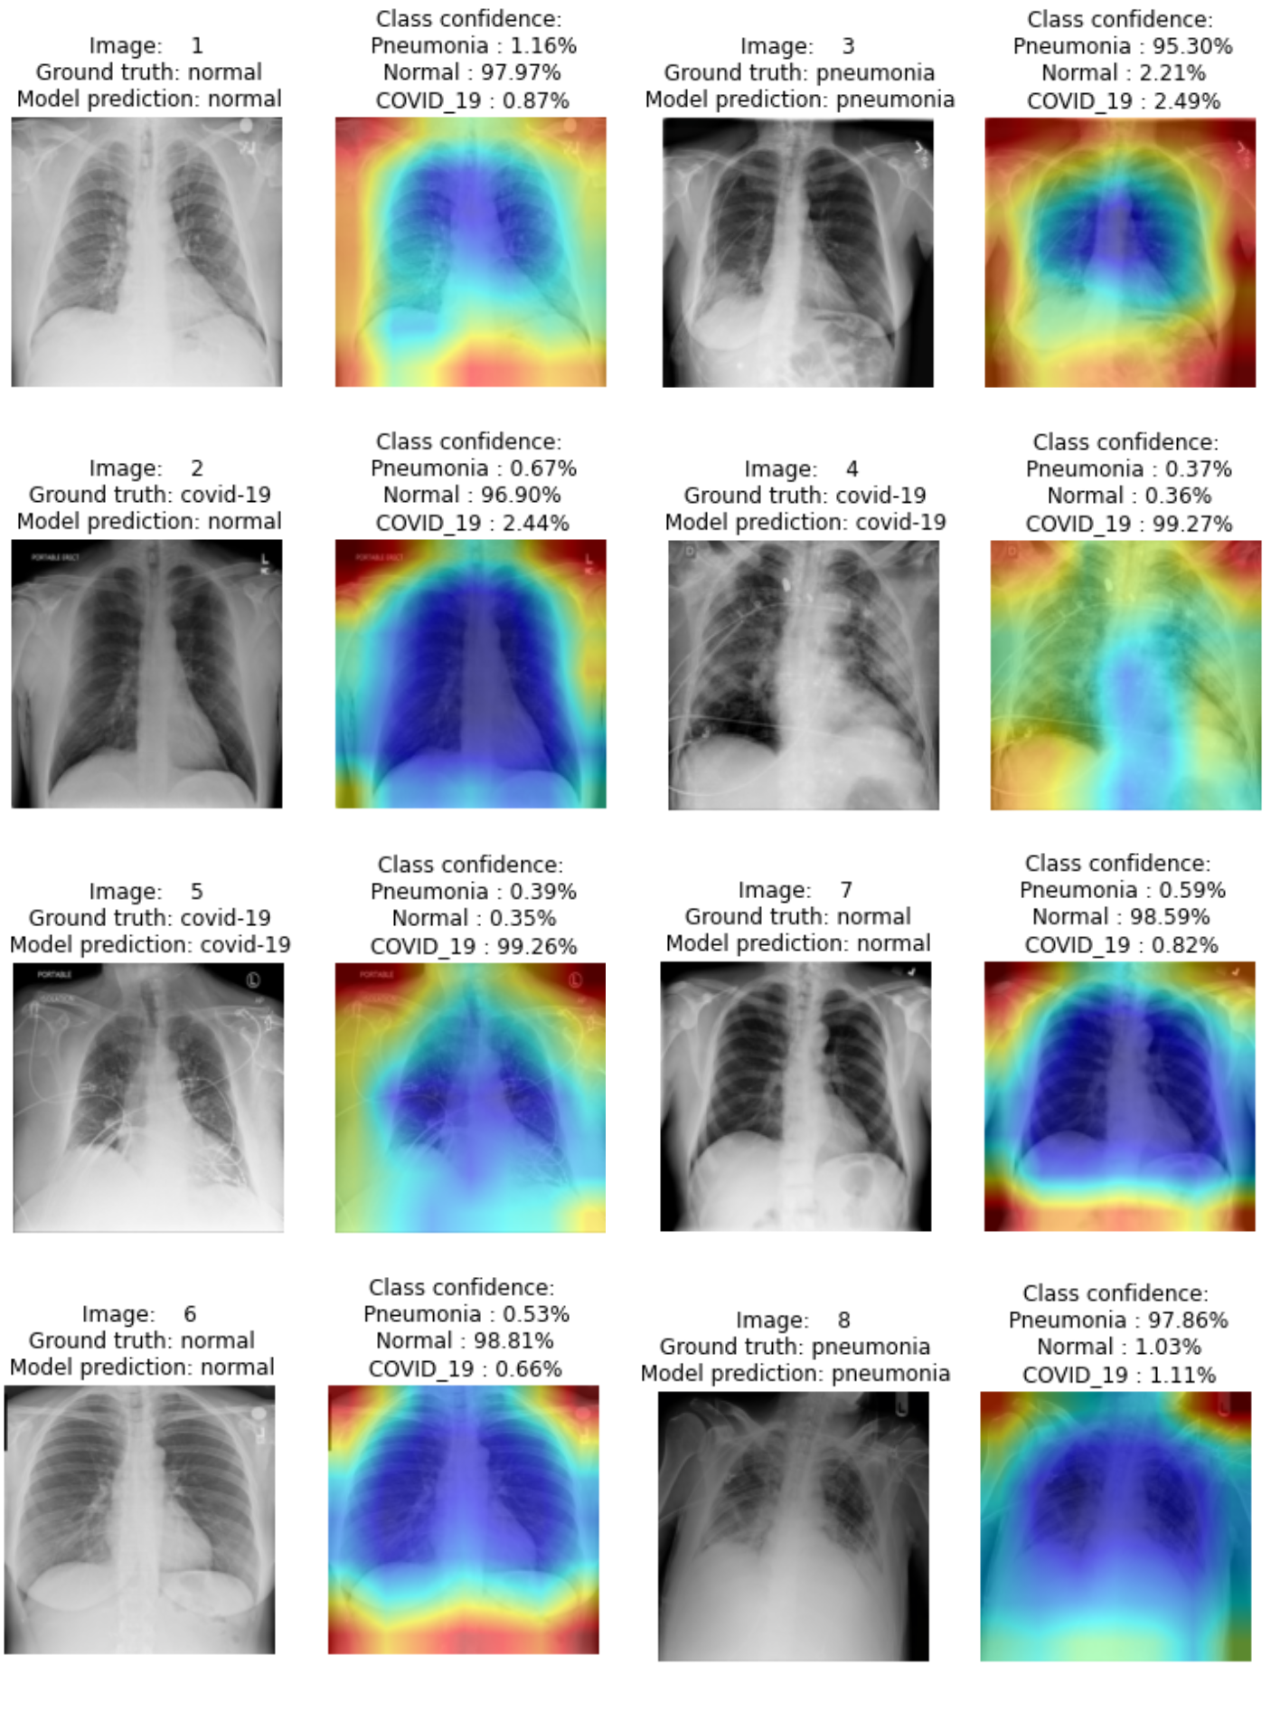

Heatmap generation by GradCAM^{(*)}
(*) Selvaraju et al. 2016

Slide 27
References
Bhattacharya S, Reddy Maddikunta PK, Pham QV, Gadekallu TR, Krishnan S SR, Chowdhary CL, Alazab M, Jalil Piran M. Deep learning and medical image processing for coronavirus (COVID-19) pandemic: A survey. Sustain Cities Soc. 2021 Feb;65:102589. doi: 10.1016/j.scs.2020.102589. Epub 2020 Nov 5. PMID: 33169099; PMCID: PMC7642729.
J. Krohn, G. Beyleveld, and A. Bassens, Deep Learning Illustrated: A Visual, Interactive Guide to Artificial Intelligence, 1st ed. Addison-Wesley Professional, 2019.
A. Dosovitskiy, L. Beyer, A. Kolesnikov, D. Weissenborn, X. Zhai, T. Unterthiner, M. Dehghani, M. Minderer, G. Heigold, S. Gelly, J. Uszkoreit, and N. Houlsby, “An Image is Worth 16x16 Words: Transformers for Image Recognition at Scale,” arXiv e-prints, p. arXiv:2010.11929, Oct. 2020.
J.-B. Cordonnier, A. Loukas, and M. Jaggi, “On the relationship between self-attention and convolutional layers,” 2020.
S. Tuli, I. Dasgupta, E. Grant, and T. L. Griffiths, “Are convolutional neural networks or transformers more like human vision?” 2021.
A. Vaswani, N. Shazeer, N. Parmar, J. Uszkoreit, L. Jones, A. N. Gomez, L. Kaiser, and I. Polosukhin, “Attention Is All You Need,” arXiv e-prints, p. arXiv:1706.03762, Jun. 2017.
M. Raghu, T. Unterthiner, S. Kornblith, C. Zhang, and A. Dosovitskiy, “Do vision transformers see like convolutional neural networks?” 2021.
H. Touvron, M. Cord, M. Douze, F. Massa, A. Sablayrolles, and H. Jegou, “Training data-efficient image transformers amp; distillation through attention,” in Proceedings of the 38th International Conference on Machine Learning, ser. Proceedings of Machine Learning Research, M. Meila and T. Zhang, Eds., vol. 139. PMLR, 18–24 Jul 2021, pp. 10 347–10 357. [Online]. Available: https://proceedings.mlr.press/v139/touvron21a.html
X. Chen, C.-J. Hsieh, and B. Gong, “When Vision Transformers Outperform ResNets without Pretraining or Strong Data Augmentations,” arXiv e-prints, p. arXiv:2106.01548, Jun. 2021
Azulay, A., Weiss,Y., “Why do deep convolutional networks generalize so poorly to small image transformations?” arXiv e-prints, p.arXiv:1805.12177, May. 2018.
W. Wang, E. Xie, X. Li, D.-P. Fan, K. Song, D. Liang, T. Lu, P. Luo, and L. Shao, “Pyramid VisionTransformer: A Versatile Backbone for Dense Prediction without Convolutions,”arXiv e-prints, p.arXiv:2102.12122, Feb. 2021.
D. Zhou, B. Kang, X. Jin, L. Yang, X. Lian, Z. Jiang, Q. Hou, and J. Feng, “DeepViT: Towards Deeper Vision Transformer,” arXiv e-prints, p. arXiv:2103.11886, Mar. 2021.
W. Wang, E. Xie, X. Li, D.-P. Fan, K. Song, D. Liang, T. Lu, P. Luo, and L. Shao, “PVTv2: Improved Baselines with Pyramid Vision Transformer,” arXiv e-prints, p. arXiv:2106.13797, Jun. 2021.
The COVIDx dataset:
Wang, L., Lin, Z.Q. & Wong, A. COVID-Net: a tailored deep convolutional neural network design for detection of COVID-19 cases from chest X-ray images. Sci Rep 10, 19549 (2020). https://doi.org/10.1038/s41598-020-76550-z
Cohen, J. P., Morrison, P., & Dao, L. COVID-19 image data collection. arXiv:2003.11597(2020)
Chung, A. Figure 1 COVID-19 chest x-ray data initiative. https://github.com/agchung/Figure1-COVID-chestxray-dataset (2020)
Chung, A. Actualmed COVID-19 chest x-ray data initiative. https://github.com/agchung/Actualmed-COVID-chestxray-dataset (2020)
Radiological Society of North America. COVID-19 radiography database. https://www.kaggle.com/tawsifurrahman/covid19-radiography-database (2019)
Radiological Society of North America. RSNA pneumonia detection challenge. https://www.kaggle.com/c/rsna-pneumonia-detection-challenge/data (2019).
M. Elgendi, M. U. Nasir, Q. Tang, D. Smith, J.-P. Grenier, C. Batte, B. Spieler, W. D.Leslie, C. Menon, R. R. Fletcher, N. Howard, R. Ward, W. Parker, and S. Nicolaou, “Theeffectiveness of image augmentation in deep learning networks for detecting covid-19: A geometrictransformation perspective,”Frontiers in Medicine, vol. 8, p. 153, 2021.
E. D. Cubuk, B. Zoph, D. Mane, V. Vasudevan, and Q. V. Le, “AutoAugment: Learning Augmentation Policies from Data,” arXiv e-prints, p. arXiv:1805.09501, May 2018.
R. R. Selvaraju, M. Cogswell, A. Das, R. Vedantam, D. Parikh, and D. Batra, “Grad-CAM: Visual Explanations from Deep Networks via Gradient-based Localization,” arXiv e-prints, p. arXiv:1610.02391, Oct. 2016.
Zhang, R. (2019). Making Convolutional Networks Shift-Invariant Again. ArXiv E-Prints, earXiv:1904.11486.

